Slide 1

Advanced Placement & Dual Enrollment
OTECH
Valencia
University of Florida
University of Central Florida
Embry Riddle Aeronautical University

Slide 2
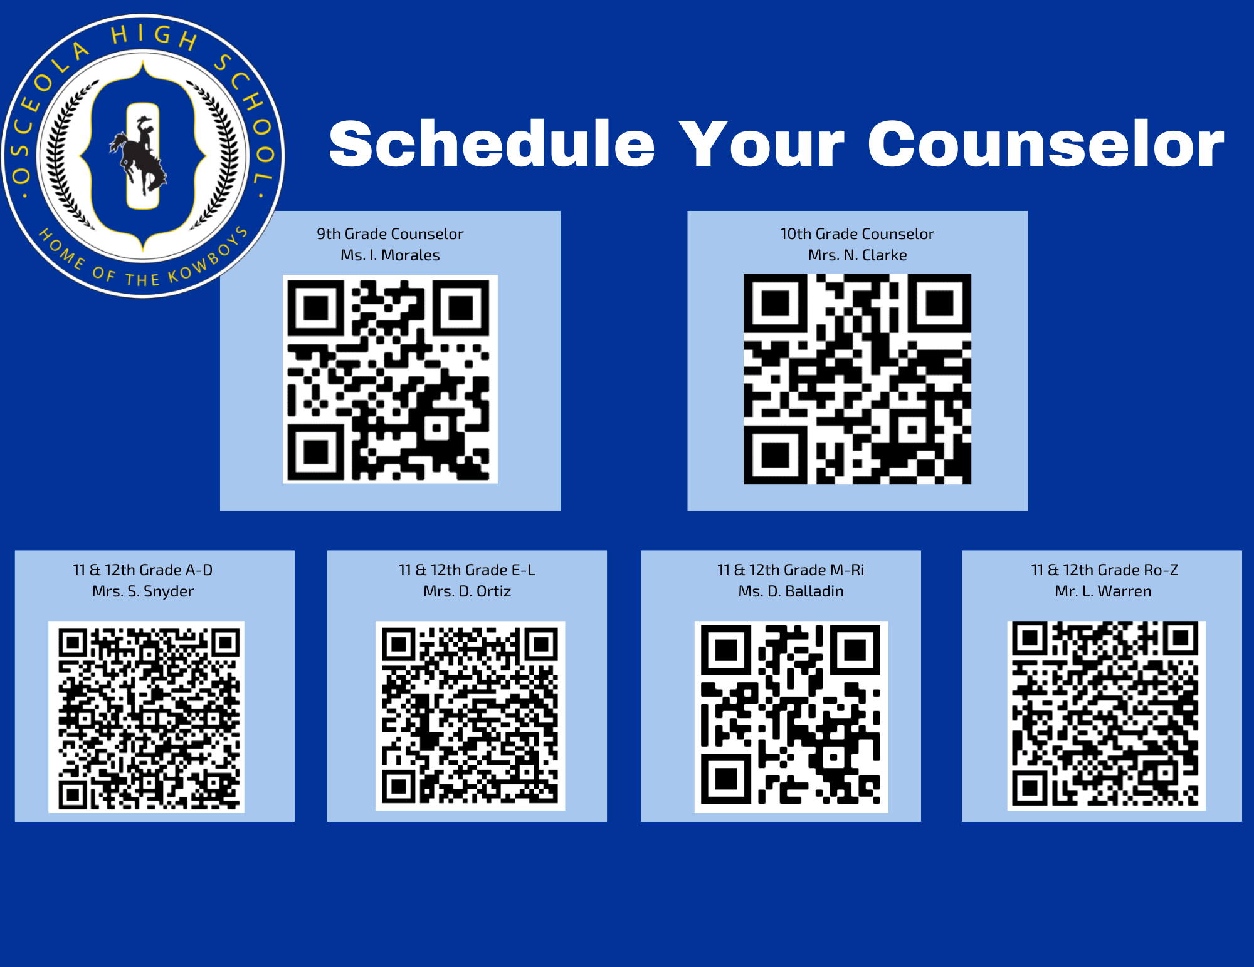
Book an Appointment with a Counselor

Slide 3
What is Advanced Placement?
The Advanced Placement® Program (AP) offers students the opportunity to take college-level courses and exams in high school and earn college credit, advanced placement, or both at many colleges and universities in the U.S. and around the world.
By earning college credit in high school and skipping introductory courses in college, your child can save time and money as they work toward a college degree.

Slide 4

Who should take AP classes?
Osceola High School's (Home of the Kowboys) Advanced Placement Scholars (K.A.P.S.) is a College Board sponsored partnership between Osceola High School, colleges, and universities. Advance Placement (AP) courses give high school students exposure to college-level curriculum and skills, coupled with the opportunity to earn college credit when a score of three or higher is earned on an AP subject exam.
This is the track for the AP Capstone Diploma Program.
Take and pass 6 AP exams including AP Seminar and Research
Level 4 and 5 on FSA/Alg 1 EOC, 3.5 and above GPA.
Goal: 100% acceptance into a top 100 university in nation.

Slide 5
Who should take AP classes?
In general, any student in grades 9–12 who is academically ready should consider taking AP. If your child has taken the PSAT 10, PSAT/NMSQT, or SAT, the AP Potential section of their online score report will indicate which AP courses your child is likely to do well in based on how they performed on the test.
Students can also get AP course recommendations from their teachers and school counselors.
The decision to take AP or DE classes depends on the student and their plan for postsecondary education. Students must research which colleges accept which courses for credit. The courses a scholar will take depend on which college or university and major that scholar wishes to pursue. It is important to know if your future major and college accepts AP credit so scholars will need to do research to create an effective high school AP plan!

Slide 6
Art History | Music Theory
Biology | Physics
Calculus AB | Psychology
Calculus BC | Spanish Language
Drawing | Spanish Literature
English Language | Statistics
English Literature | Studio 2D Art
Environmental Science | U.S. Government and Politics
Human Geography | U.S. History
Macroeconomics | World History
Computer Science Prin | Physics C: Electricity and Magnetism
Computer Science A | Physics: Mechanics
Here are the Advanced Placement courses offered at Osceola High School:
Note: AP course availability can change annually depending on instructor availability. Please keep up with current information regarding this courses by visiting this page or contacting the counselor at the information below.

Slide 7
What is Dual Enrollment?
Dual Enrollment is an acceleration program that allows secondary students to take postsecondary coursework and simultaneously earn credit toward a high school diploma, a career certificate, an industry certification, or an associates (2 year) degree.
DE Options at OHS:
Osceola Technical College (OTECH)
Valencia College
University of Florida
University of Central Florida
Embry Riddle Aeronautical University

Slide 8
Who Should do DE?
Good Grade Point Average:
3.0 or higher for Valencia, UF, and UCF.
2.0 or higher for OTECH.
Characteristics:
Good Attendance
No Discipline Issues
Hard-worker
Independent
Reliable
Mature
Highly Motivated
Self Starter
Good Time Manager
Grade Level Recommendations:
Rising 10th, 11th, 12th graders
OTECH only accepts 11th and 12th graders.

Slide 9
Advantages to DE:
Be more competitive when applying to college.
Shorter time obtaining a Bachelor’s Degree or Certification.
Better preparation for the rigors of college or trade school.
Save $$$

Slide 10
Potential Disadvantages to DE:
Some Private/Out-of-State Colleges do not accept DE credits.
Some schools prefer AP over DE because it is a Nationally Recognized Curriculum.
DE Grades can affect Bright Futures and/or 4 year college admissions.
Too many withdrawals can affect financial aid.
Poor grades remain permanently on college transcripts.

Slide 11
When to Apply:
We will keep you updated with deadlines but you should be aware of deadlines for the school with which you want to dual enroll! It is good practice to keep track—it will prepare you for when college applications are due. ☺

Slide 12


Slide 13
Valencia College : how to Apply for Fall 2022
You must have a 3.0 Unweighted GPA to apply (or a 3.0 Weighted for Seniors).
1
You must apply to Valencia before you do anything else. The application is free, online, and CLOSES MARCH 1^{ST!}
2
Click “Apply Now” and complete your application.
3
Take the PERT and achieve passing scores.
4
If the student applied in the past but was not admitted, they will have to reapply.
5

Slide 14
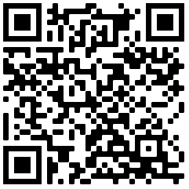
Valencia College :
How to Apply for Fall 2022
It is free to apply. If at any point you are prompted to pay, you have completed the wrong application.
There is step-by-step application help, FAQs, Application Instructions, and the Application here
If you have questions about the application, you should become familiar with reaching out to Valencia College– they are the ultimate resource for you.

Slide 15
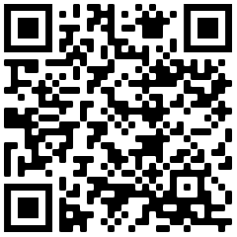
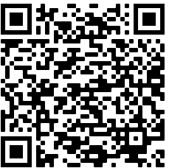
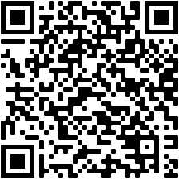
Valencia College :
How to Apply for Fall 2022
All About the PERT
You must pass the following three sections of the PERT, ACT, or SAT to be accepted into Valencia. Test scores are due to Valencia by April 12th, 2022.
Acceptable scores:
  PERT: Writing (103), Reading (106), Math (114 Intermediate Algebra. 123 College Algebra)
  SAT: Writing (25), Critical Reading (24), Math (24 Intermediate Algebra or 26 College Algebra)
  ACT: Reading (19), English (17), Math: (19 Intermediate Algebra or 21 College Algebra)
Students are responsible for sending their SAT and ACT scores directly to Valencia. Please keep in mind these scores can take up to 5 weeks to reach the college and must be received by April 12th, 2022. This means you will need to send them immediately.
The PERT test will be given at OHS again on March 25th (MATH) and March 26th (Reading/Writing).
If you want to take the PERT at OHS be sure you apply to Valencia College Dual Enrollment by March 1st !
If the student misses the test that day or doesn’t get the score they need, they can take the PERT again with Valencia prior to April 12th through their testing platform. The student will be responsible for registering with Valencia College to take the PERT.
How to Send Your SAT Scores to Colleges
How to Send Your ACT Scores to Colleges

Slide 16
Valencia College dual enrollment: how to Apply for Fall 2022
If you meet all requirements, you will be accepted into the Dual Enrollment program. They will send you an email acceptance letter. Once your school counselor is notified of all final acceptances, we will call you down to go over the rest of the dual enrollment process.

Slide 17


Applying to UF Dual Enrollment
Express interest to school counselor
Submit an application on our website
  Opened February 7th, 2022
  Closes April 15th, 2022
Stay connected to email for continued communication

Slide 18
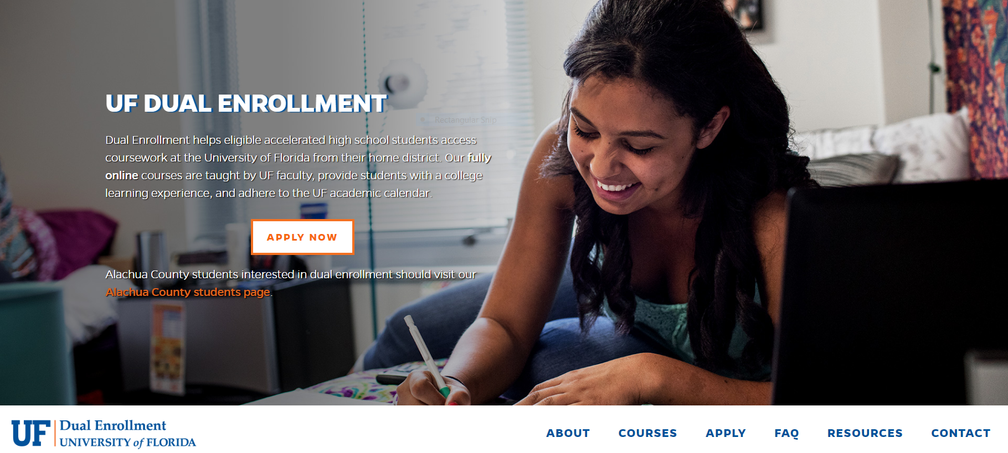

dualenrollment.dce.ufl.edu

Slide 19

OUR COURSES
Vary term to term
Cover a wide range of subject areas
Provide a rigorous collegiate experience
No easy A’s

Slide 20

ADVISING
Before registration:
Application
Course Selection
Enrollment
Textbook Arrangements
After registration:
Semester Check-ins
Any time by phone or e-mail!

Slide 21
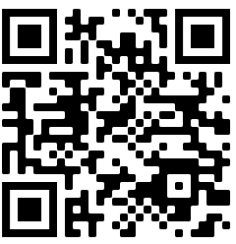
UF:
How to Apply for fall 2022
College-level courses are 100% online and are created and taught by top UF professors and instructors.
Fall 2022 Application is open from February 7th 2022 through April 15th, 2022.
If you have any questions please contact UF at:
  352-273-4155
  dual-enrollment@dce.ufl.edu
  Complete the contact form on their website.

Slide 22

Contact Information
Litza Echeverria Rubio, Ed.S.
Academic Program Manager
Distance & Continuing Education
University of Florida
Dual-enrollment@dce.ufl.edu
352-273-4155
Allison Costa
Academic Program Coordinator
Distance & Continuing Education
University of Florida
Dual-enrollment@dce.ufl.edu
352-273-4155

Slide 23

Welcome to Admissions Orientation for
Career Dual Enrollment

Slide 24

Today's Agenda
Administration and Student Services
Admissions Process
Financial Aid
Program Overview

Slide 25
What is Dual Enrollment?
High School Career Dual Enrollment is an opportunity for high school students to enroll in oTECH postsecondary courses that are weighted and creditable toward high school graduation requirements as well as postsecondary career and technical program credits and certifications.
Juniors and seniors may participate in dual enrollment provided they meet all high school graduation requirements.

Slide 26

What We Offer...​
  One of the program choices you select during your junior/senior year while you prepare to graduate from high school. ​
  At oTECH you can study a trade and earn a certification/s for that career.​
  Earn acceleration points creditable towards high school graduation.
  Earn credits towards an A.S. Degree with successful completion of our program with Valencia.

Slide 27
Career Dual Enrollment Requirements
Minimum 2.0 unweighted GPA
Student meets minimum graduation requirements at time of application
Student has successfully demonstrated mastery on the FSA exam during their 10th grade year or has produced an appropriate concordant score on the PERT, SAT, or ACT exam or has an official FSA waiver from their home school
Student must have minimal attendance issues (i.e. tardiness, absences, skipping class)
No level 3 referrals or higher within previous 6 months
History of satisfactory academic progress
TABE test required within the first 6 weeks of start date (to be taken at oTECH)
To complete the program, the student will be required to enroll as an adult after graduation, to complete the remaining scheduled hours.

Slide 28
Are there any fees for High School Career Dual Enrolled Students?
Osceola County public high school students are provided tuition, lab fees, and textbooks FREE of charge.
Some programs may require additional supplies not covered by the school district.
Out of pockets expenses for uniforms can range from $25-$100, parking fee of $30, etc.

Slide 29
Schedule
Schedules:
  Morning: 7:10 AM-10:10 AM (M/T/R/F);
(W) 7:10 AM-9:40 AM
  Afternoon: 11:10 AM-2:10 PM (M/T/R/F);
(W)10:40 AM-1:10 PM
  Full Time: 7:10 AM- 2:10 PM (M/T/R/F);
(W)7:10 AM-1:10 PM
    Students should have the opportunity to eat on our campus either before their class starts or after their class is over.

Slide 30
Industry Certifications
Students are expected to take the industry certifications attached to their program. These tests are program mandates and assist the student in securing employment opportunities.
Dual enrollment students first attempt is at no cost to the student. Additional attempts will be at the cost of the student.
Most certifications are provided at the oTECH Kissimmee campus, but it is possible that students will have to take a certification at an off-campus testing site. This will be clearly communicated.

Slide 31
Transitioning from Dual Enrollment to Adult/Financial Aid
Students may not finish the entire program depending on:
  Length of the Program
  When you start the program
  Full or Part Time Schedule
You may need to return as an adult student to finish your program.
Any dual enrollment student who needs to remain at oTECH after high school graduation to complete their program will be provided guidance and services throughout the process.
Financial Aid is available to those who qualify. oTECH’s Financial Aid department is here to help you through the process!

Slide 32



Review of Information
Please check out our website for in depth information
If you have questions after today, please email:
Jennifer.Aviles2@osceolaschools.net
https://www.osceolaschools.net/otech
Facebook: weareoTECH
Twitter: @weareoTECH

Slide 33
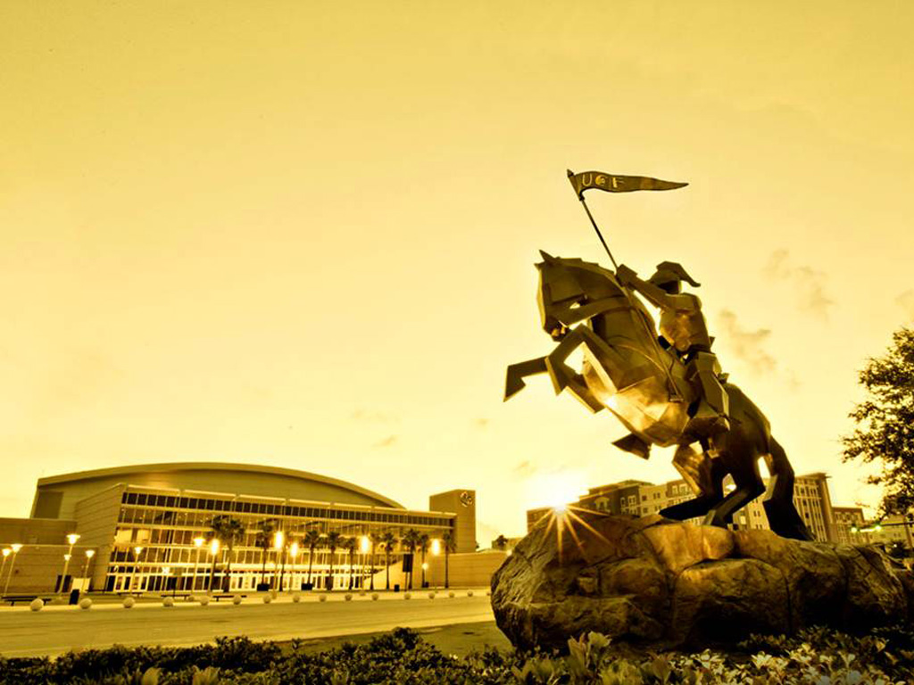
University of Central Florida
Dual Enrollment & Early Admission
Admissions Contact
Lyndsey Holland,
Assistant Director
Email: dualenrollment@ucf.edu

Slide 34

DE vs EA: What’s the Difference?
Dual Enrollment (DE) students enroll on a part time basis and can take a maximum of 6 credits per semester.
Early Admission (EA) students enroll on a full time basis and must take at least 12 credits per semester but not exceed 15 credits per semester.
Both programs present the student with the opportunity to earn 1.5 years of college education at one of Florida’s premier 4-year institutions.

Slide 35

HOW TO APPLY
The school/county must have an articulation agreement on
file with UCF.
Complete an application form
(UCF online application only)
  November 1 for Spring
  March 1 for Summer
  May 1 for Fall
Submit Official high school transcript
(GPA is recalculated on academic core)
SAT/ACT scores
Students must meet minimum academic qualifications
to be eligible:
3.8 Recalculated GPA 1330 rSAT 28 ACT

Slide 36

AUTHORIZATION FORM
If admissible, student’s parent and high school counselor will be sent an authorization form via email.
The Authorization Form must be signed by student, parent and guidance counselor listing courses the student is approved to take.
Submission requirements
  New students: submit through link emailed out
  Returning students: High School Professional Submits to College Academic Advisor (based on major)
The Authorization Form is required for tuition and instructional materials

Slide 37

IMPORTANT NOTES
Submit documents for declaration of Florida residency (Early Admission only).
EA students have the option to apply for on campus housing.
EA students are NOT eligible for merit-based scholarships
DE/EA students do not pay the $200 enrollment deposit.
Submit the immunization form prior to registration.
Orientation is required for EA students.
DE students are NOT automatically admitted to UCF after high school graduation.

Slide 38

IMPORTANT NOTES (cont)
Enrolling in Approved Courses
Dual enrollment/early admission students may enroll only in approved courses from the Authorization Form
Students are responsible for processing their own enrollment
  If classes are full, students will need to place themselves on the waitlist for that course section and/or attempt to enroll in another section or (approved) course
Dual Enrollment Program students are strongly encouraged NOT to Drop/Swap courses. If you must Drop/Swap courses:
  You can only do so with a previously approved course from your Authorization Form.
  You must email your high school Principal or Guidance Counselor AND the UCF DEP Coordinator
ANY CHANGES TO SCHEDULE AFTER THE ADD/DROP/SWAP PERIOD MUST BE APPROVED BY HIGH SCHOOL GUIDANCE COUNSELOR
  Impact on high school graduation status
  Impact on college admissions status
Students must request their official UCF transcript to submit to the high school (this is not done automatically)

Slide 39
Questions?
Please visit one of our tables:
Guidance/Advanced Placement
Valencia & UF
UCF
Embry Riddle Aeronautical University

